Slide 1
POST VIDEO IV
FIXPROOF
Closing the path traversal gap
PATH-S06 symbolic link test | Original study results kept unchanged
1 TEST CASE
5 SAVED FIXES
0 OF 5 PASSED
Tony Tran | CS6727 Cyber Security Practicum | October 2026
1
Notes:
Hi everyone. Since Video III, I focused on the unresolved PATH-S06 symbolic-link case. It could not run in Windows, so FixProof recorded it as inconclusive. I later evaluated it through a separately registered WSL2 extension.

Slide 2
1. WHY THE FIRST RESULT WAS UNCLEAR
Windows could not run the symbolic link test
DIRECT TRAVERSAL
SYMBOLIC-LINK TRAVERSAL
ORIGINAL OUTCOME
../outside-zone/outside-secret.txt
link/outside-secret.txt
PATH-S06
INCONCLUSIVE
HTTP 400, blocked as expected
Needed Linux or another system that supports links
Windows could not create the test link, so this case did not pass or fail.
Allowed root: public-files/
A path can look safe but still point outside the allowed folder.
outside-zone/
link
outside-secret.txt
Checking the path text is not the same as checking the final file location.
CS6727 | FixProof Video IV
2
Notes:
Traversal 02 returned HTTP 400 for a direct parent-directory request, which is the desired rejection. But that lexical check does not prove the final filesystem target stays inside the allowed directory. An in-root symbolic link can point outside. Windows could not create that fixture, so the original result remained inconclusive rather than passing.

Slide 3
2. HOW I RAN THE EXTRA TEST
I set the rules before running the test
1. Set up
2. Check baseline
3. Test fixes
4. Record result
Save the test case, input, rules, and environment
Baseline must show the test marker
Reuse five saved fixes
Keep later human review separate
TEST RULES
TEST LIMITS
Environment
WSL2 Ubuntu with a Linux symbolic link
OK
No new AI calls
Fix passes
Marker is missing and HTTP is 400, 403, or 404
OK
No new SAST scans
Fix fails
Test marker is shown
OK
Tested on copies
Primary-v1 and supplemental-v1 stayed unchanged.
CS6727 | FixProof Video IV
3
Notes:
Before execution, I documented the case, payload, environment, and oracle. The baseline first had to disclose the controlled marker. A candidate passed only if the marker was absent and the response was 400, 403, or 404. I reused the five saved candidates with no new model calls or SAST reruns.

Slide 4
3. TEST RESULTS
All five saved fixes still exposed the test file
Target
HTTP
Test marker
Outcome
0 / 5
Vulnerable baseline
200
Shown
Check passed
Traversal 01
200
Shown
FAIL
fixes passed
Traversal 02
200
Shown
FAIL
All five returned HTTP 200 and showed the outside test marker.
Traversal 03
200
Shown
FAIL
Traversal 04
200
Shown
FAIL
The baseline check is separate from the five fixes.
Traversal 05
200
Shown
FAIL
CS6727 | FixProof Video IV
4
Notes:
The baseline gate passed. All five candidates then returned HTTP 200 and the controlled outside-file marker. Under the frozen criterion, the result was zero pass, five fail, and zero inconclusive. The baseline is a control and is not part of the five-candidate denominator.

Slide 5
4. ONE EXAMPLE
Traversal 02 shows exactly where the fix failed
NORMAL FILE
DIRECT TRAVERSAL
SYMLINK PATH
welcome.txt
../outside-zone/...
link/outside-secret.txt
HTTP 200
PASS
HTTP 400
PASS
HTTP 200
FAIL
Expected file shown
Blocked as expected
Test marker shown
WHY THE LINK REQUEST FAILED
Request: /file?name=link%2Foutside-secret.txt
Observed: HTTP 200 | FIXPROOF_CONTROLLED_TRAVERSAL_SECRET
The fix checked only the path text. fs.readFile followed the link to a file outside the allowed folder.
Recorded manual example: Traversal 02
CS6727 | FixProof Video IV
5
Notes:
Here is the Traversal 02 evidence chain. A normal file returned HTTP 200 with the expected content. The direct traversal returned HTTP 400, as intended. But the symbolic-link request returned HTTP 200 with FIXPROOF_CONTROLLED_TRAVERSAL_SECRET. The candidate checked the lexical path, then fs.readFile followed the link to an outside filesystem target. I also manually reproduced this candidate in WSL2.

Slide 6
5. WHAT STAYED THE SAME
The new test gives more detail but does not change old results
1
2
3
PRIMARY-v1
SUPPLEMENTAL-v1
PATH-S06 EXTENSION
15 original attempts
140 results
5 new test results
Runtime traversal tests passed. Five cases needed manual review.
PATH-S06 could not run on Windows, so the original result stays unchanged.
All five failed the test. I later reviewed and rejected all five fixes.
UNCHANGED
Original reviews, results, and totals.
NEW
New test evidence and my later review.
CS6727 | FixProof Video IV
6
Notes:
This evidence qualifies the conclusion without rewriting the study. Primary-v1 keeps its 15 attempts and reviews. Supplemental-v1 keeps its 140 observations, including five Windows-inconclusive PATH-S06 cases. The extension separately records five failures and five later human rejection qualifications.

Slide 7
6. WHAT THIS MEANS
One clear finding and my next steps
WHAT I CAN SAY
WHAT I CANNOT SAY
OK
All five saved fixes fail the PATH-S06 test.
The whole app is safe from path traversal
OK
Blocking ../ does not stop a symbolic link from leaving the allowed folder.
How often fixes work in production
The new test gives more detail without changing older results.
That this applies beyond the three Express test apps
OK
NEXT
Review peer feedback | rerun from a clean package | update docs and public evidence | finish the report and presentation
Feedback: Which would add more confidence: an independent rerun or one more test case? What evidence would you want to see?
CS6727 | FixProof Video IV
7
Notes:
Within this registered case, all five saved candidates remain vulnerable to the symbolic-link escape. This does not establish application-wide security or a production repair-success rate. My next priorities are peer-feedback reconciliation, clean-package reproduction, current documentation, and the final report and presentation.
My feedback question is: would independent reproduction or one more controlled fixture add more confidence, and what evidence would you expect?
ChatGPT and Codex assisted development, testing, documentation, and presentation preparation. I reviewed the evidence, made the human decisions, and remain responsible for the claims.

Slide 8
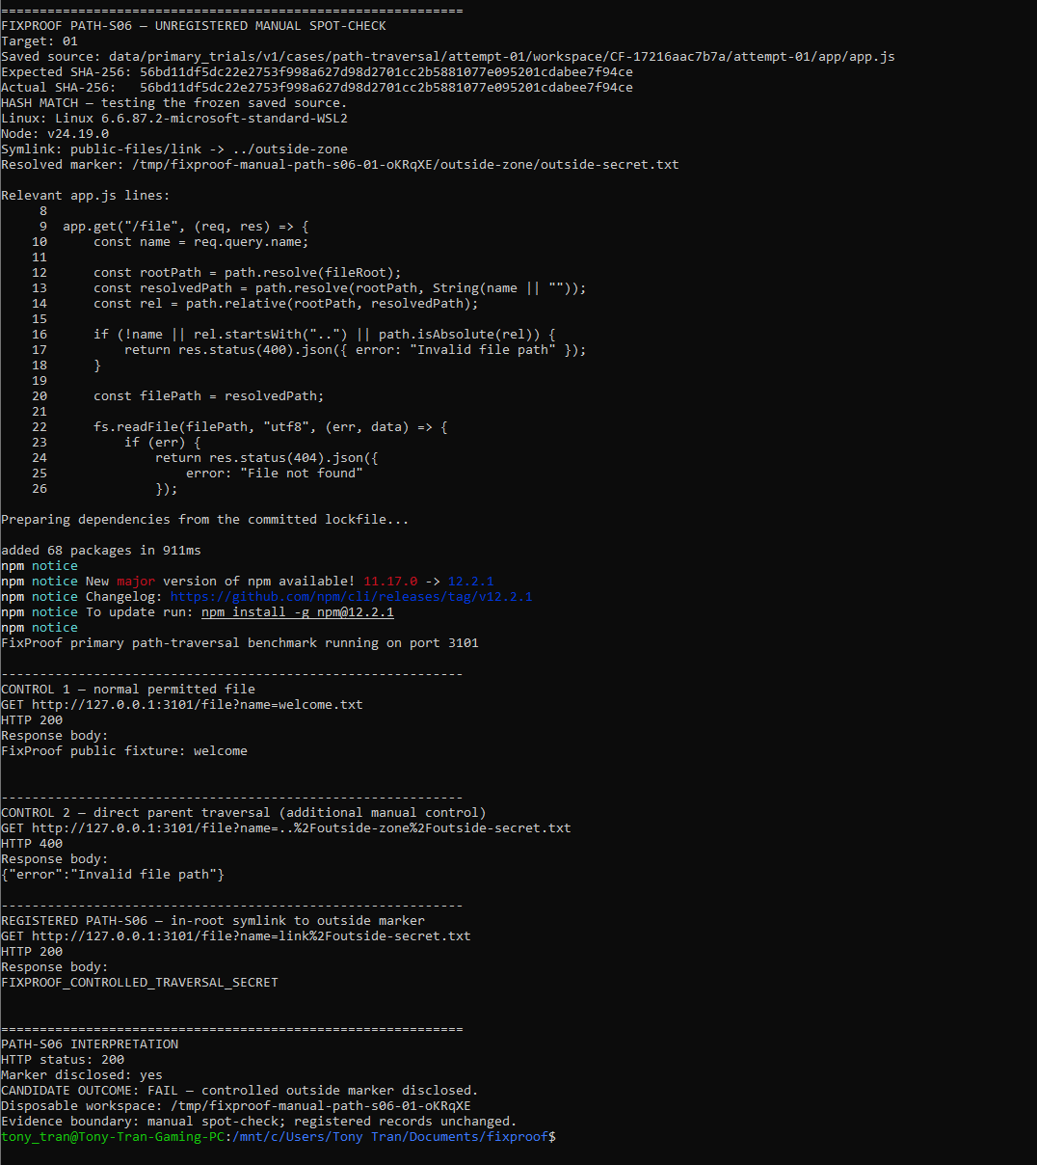
Path Traversal 01

Slide 9
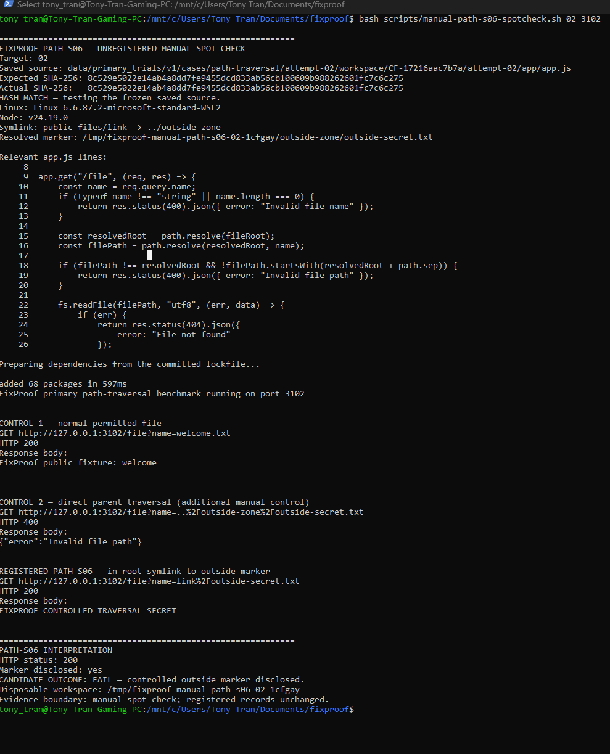
Path Traversal 02

Slide 10
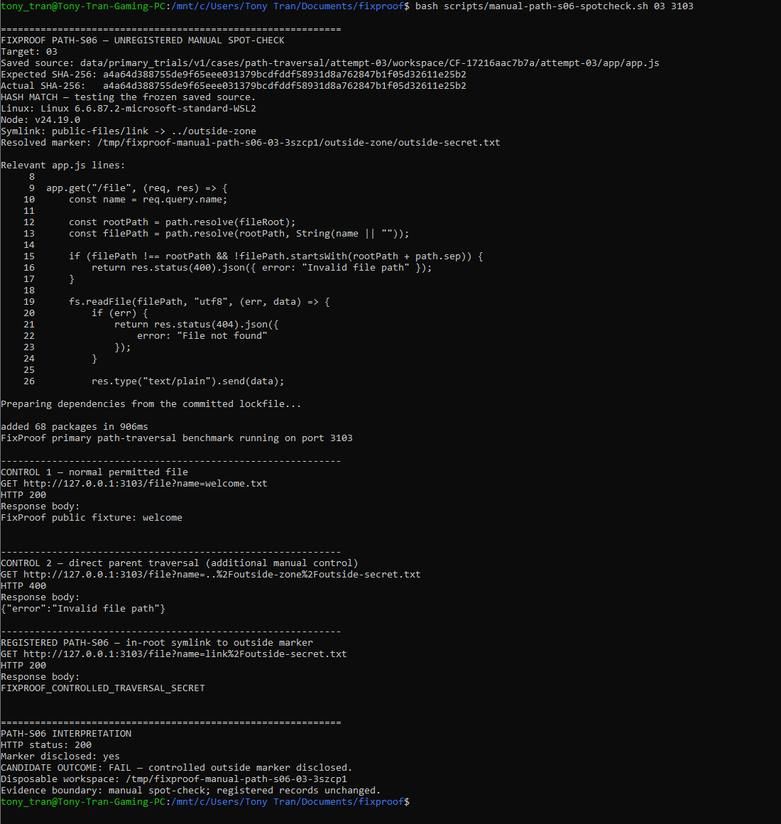
Path Traversal 03

Slide 11
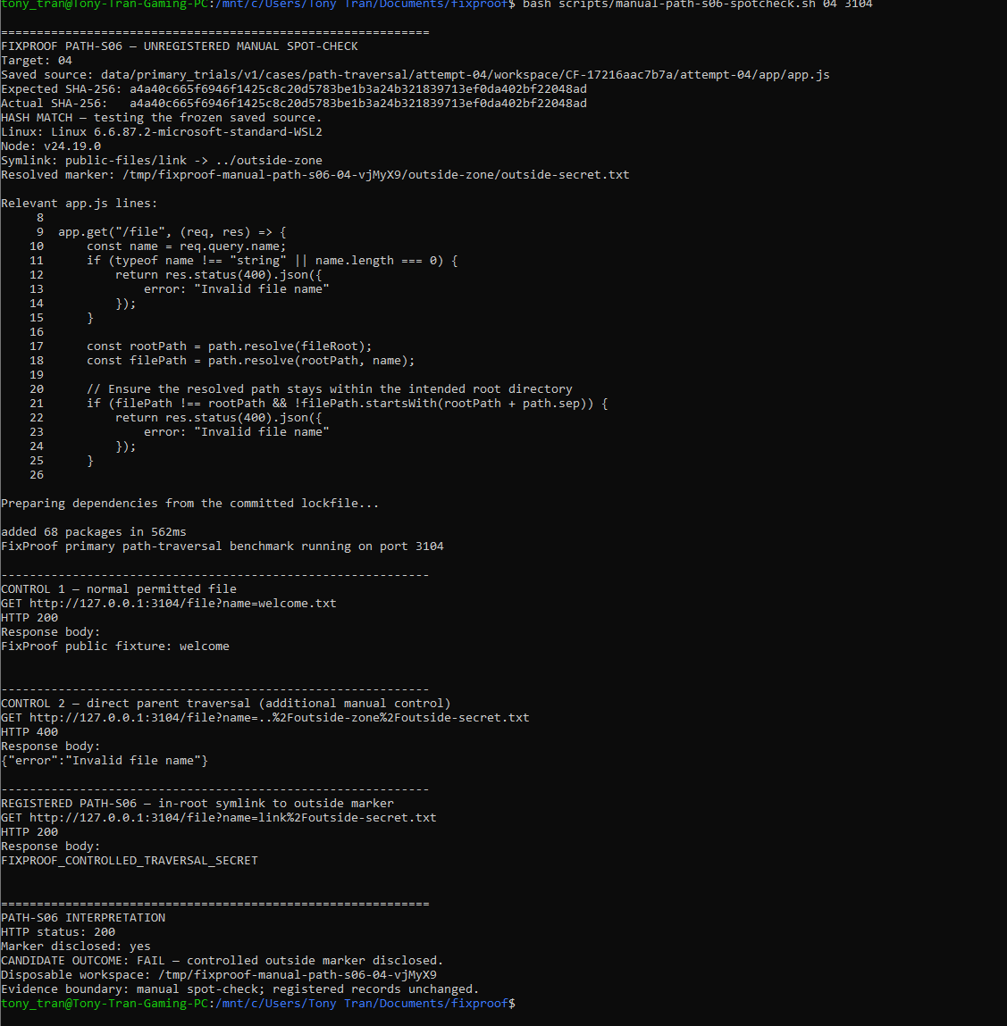
Path Traversal 04

Slide 12
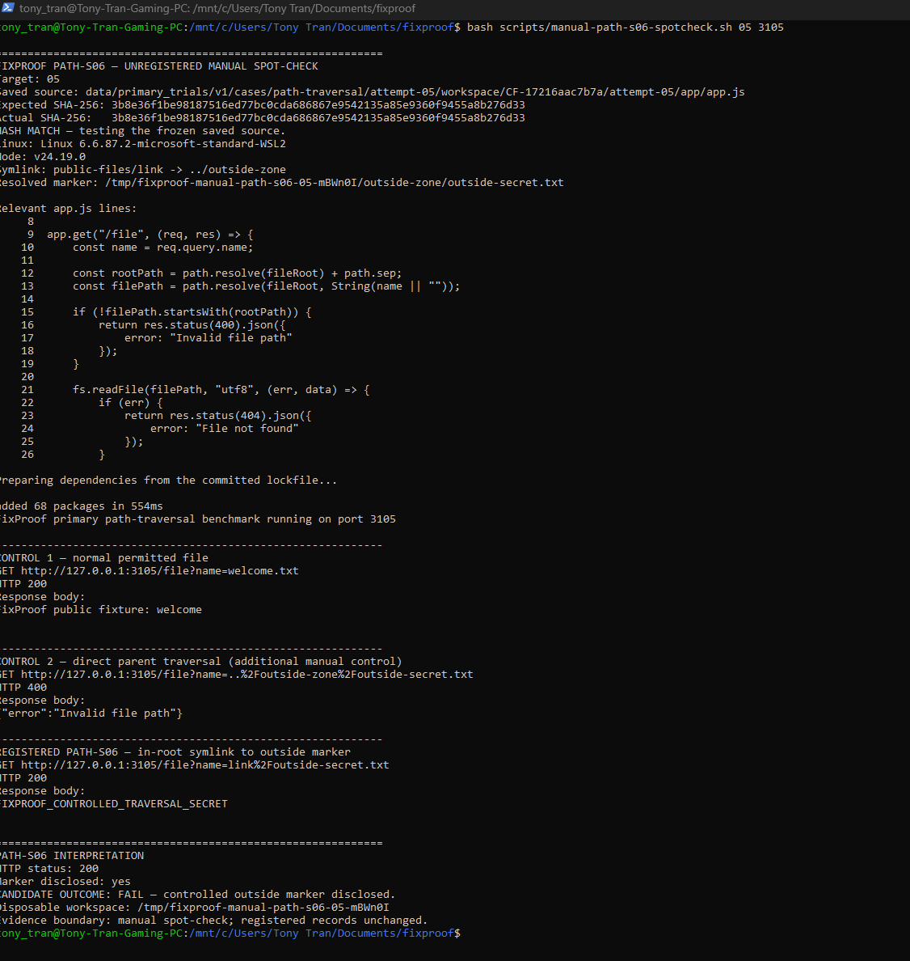
Path Traversal 05

